Slide 1
Cloud Computing
Atul Kahate

Slide 2
Session 1: Introduction to Cloud

Slide 3
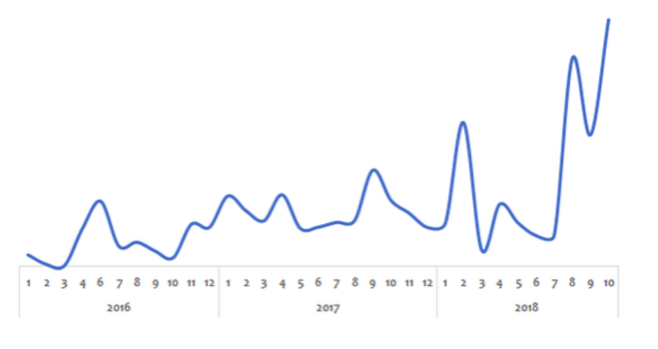
Why Cloud?
Peak loads vary (high during weekends and holidays)
Solution before Cloud: Peak Load Provisioning – Buy infrastructure for peak load – Wasted during less load

Slide 4
Challenges Before Cloud
High cost of infrastructure procurement
Need to plan ahead of time – Can we guess if a start up will be successful?
Low utilization of infrastructure due to peak load provisioning
Dedicated infrastructure team for maintenance

Slide 5

The Cloud Solution
Provision (i.e. rent) resources only when we need them, and release them when we do not need them
On demand resource provisioning
Hence called as elastic

Slide 6
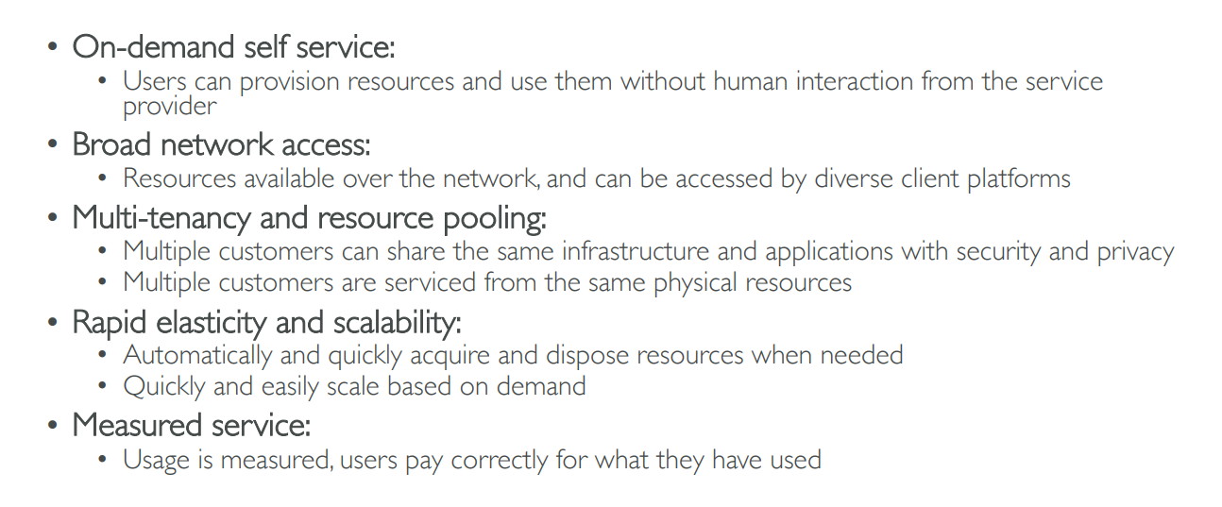
Five Characteristics of Cloud Computing

Slide 7
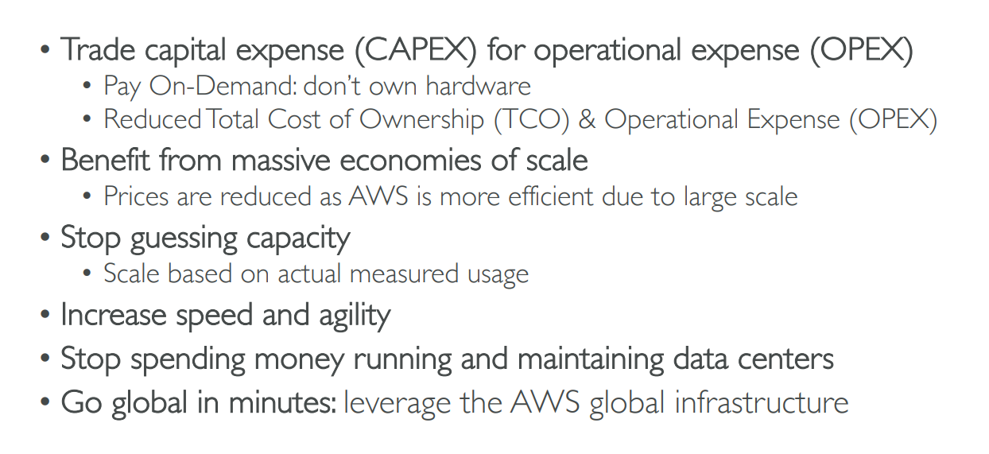
Six Advantages of Cloud Computing

Slide 8
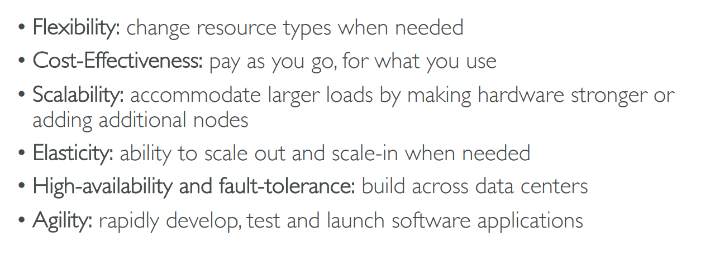
Problems solved by the Cloud

Slide 9
NIST Definition
Cloud Computing is a model for enabling convenient, on-demand network access to a shared pool of configurable computing resources (e.g., networks, servers, storage, applications, and services) that can be rapidly provisioned and released with minimal management effort or service provider interaction.

Slide 10
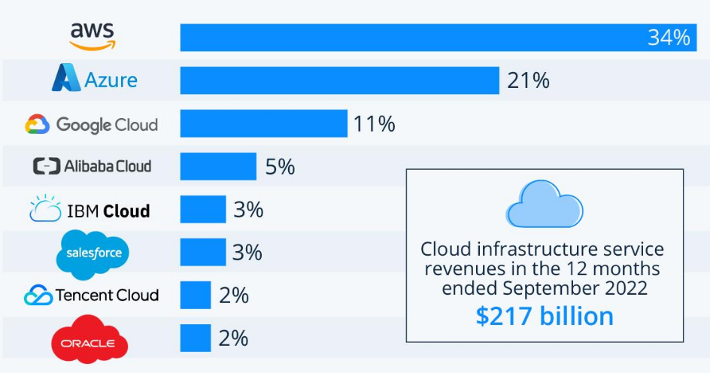
Cloud Vendors
Amazon Web Services (AWS)
Microsoft’s Azure
Google Cloud Platform (GCP)

Slide 11
Session 2: Cloud Models or Managed Services

Slide 12
Managed Services / Cloud Computing Types
Do you want to continue running applications in the cloud, the same way you run them in your data center?
OR are there OTHER approaches?
We should understand some terminology used with cloud services:
IaaS (Infrastructure as a Service) – Hosting
PaaS (Platform as a Service) – App Development
SaaS (Software as a Service) – Everything
Sometimes also called as the SPI model (Saas, Paas, Iaas)

Slide 13
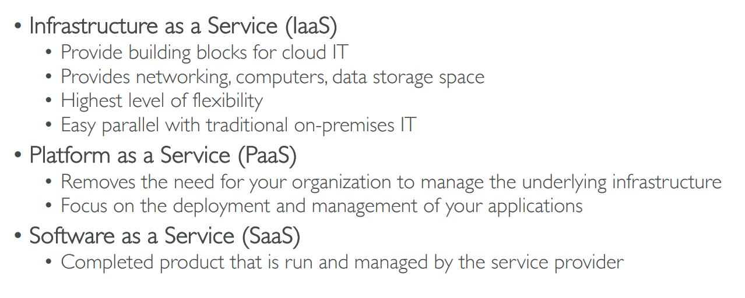
Iaas, Paas, SaaS

Slide 14
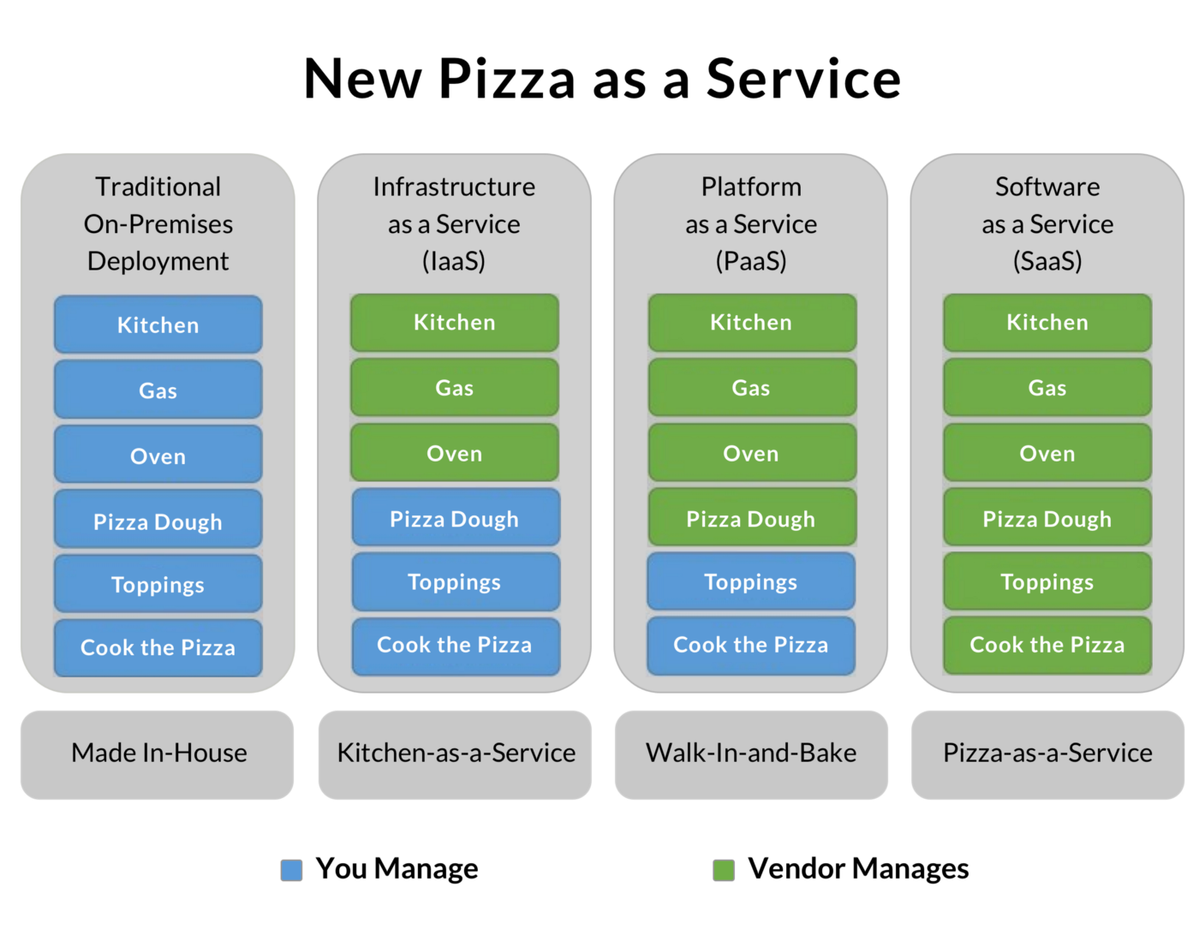
IaaS, PaaS, SaaS

Slide 15
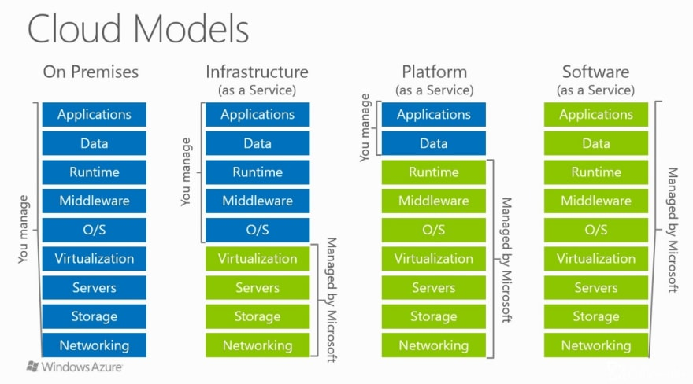
IaaS, PaaS, SaaS

Slide 16
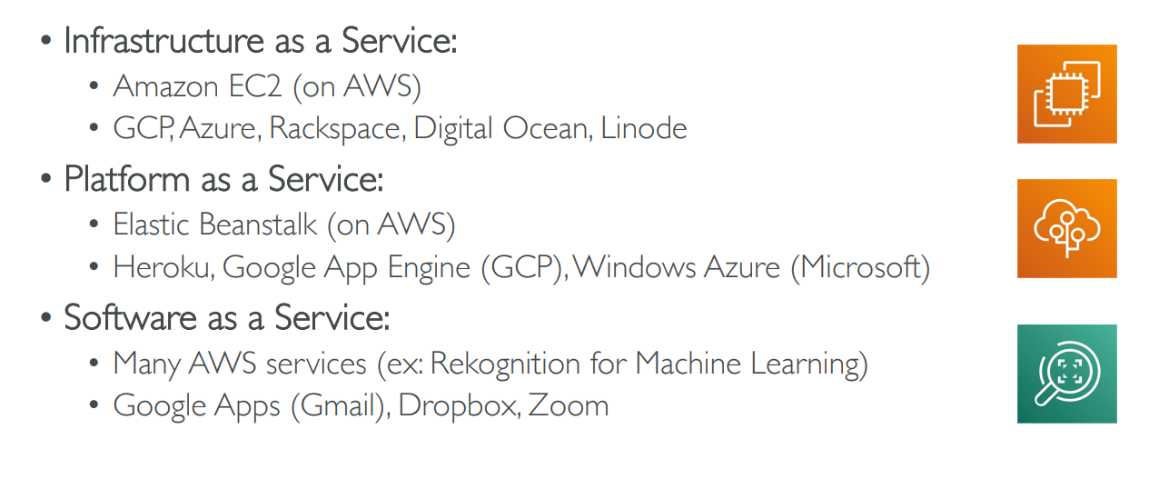
Example of Cloud Computing Types

Slide 17
Iaas: Virtualization

Slide 18
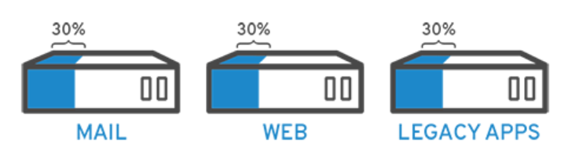
What is Virtualization?
Virtualization allows you to use a physical machine’s full capacity by distributing its capabilities among many users or environments
Example: Suppose we have three servers – 30% of capacity is used in each case
What can be done?

Slide 19
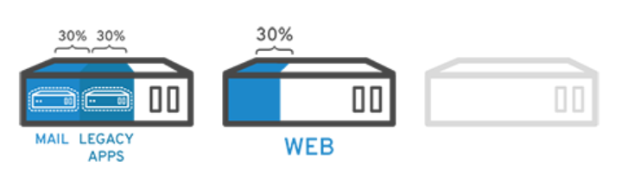
Solution: Virtualization
It does not stop here!
Keeping security in mind, you could split the first server again so it could handle another task—increasing its use from 30%, to 60%, to 90%. Once you do that, the now empty servers could be reused for other tasks or retired altogether to reduce cooling and maintenance costs.

Slide 20
How does Virtualization Work?
Virtualization is done using hypervisor
Hypervisor: A program that sits between the real (physical) machine and the virtual machine, enabling interaction between the two
Software called hypervisors separate the physical resources from the virtual environments—the things that need those resources
Hypervisors can sit on top of an operating system (like on a laptop) or be installed directly onto hardware (like a server), which is how most enterprises virtualize
Hypervisors take your physical resources and divide them up so that virtual environments can use them

Slide 21
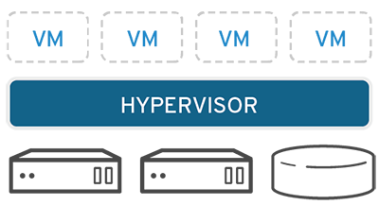
Resource Partitioning
Resources are partitioned as needed from the physical environment to the many virtual environments
Users interact with and run computations within the virtual environment (typically called a guest machine or virtual machine)
The virtual machine functions as a single data file
It can be moved from one computer to another, opened in either one, and be expected to work the same

Slide 22
Virtualization – Good References
https://www.ibm.com/cloud/learn/virtualization-a-complete-guide
https://www.stl.tech/blog/introduction-to-virtualization/

Slide 23
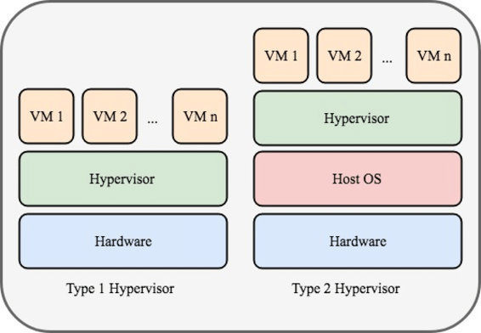
Virtualization Types

Slide 24
Type 1 and 2
Type 1 Hypervisors (Full Virtualization or Hardware Virtualization) sit between the hardware and your virtual machines AND your Host OS.
In effect, your Host OS is turned into a virtual machine as well. Each Guest OS has direct access to the native hardware via interface built into the Hypervisor.
Type 2 Hypervisors (Para Virtualization) sit between your virtual machines AND your Host OS.
The Guest OSs do not have direct access to Host hardware, and use emulated drivers.

Slide 25
Another important point
Type 1 Hypervisor is called a native or Bare Metal Hypervisor while type 2 Hypervisor is called a Host OS Hypervisor

Slide 26
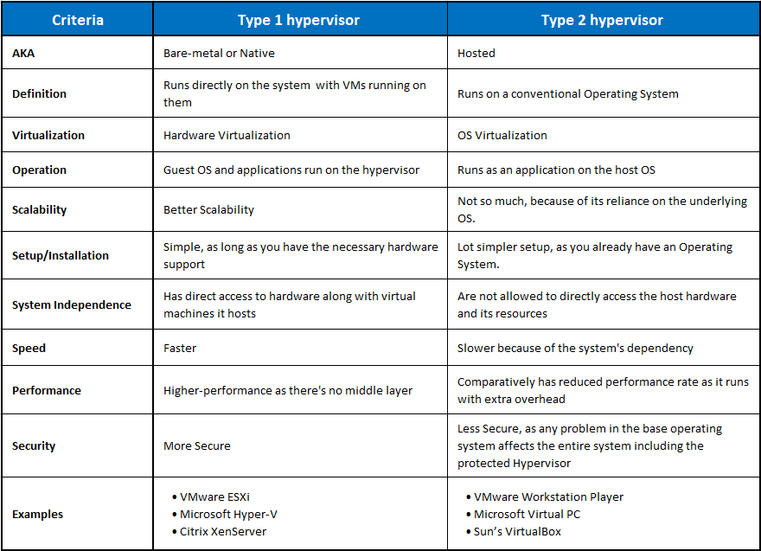

Slide 27
PaaS: Example: RAID

Slide 28
Redundant Array of Inexpensive Disks (RAID)
CPU performance has been increasing exponentially over the past decade, roughly doubling every 18 months
Not so with disk performance
In the 1970s, average seek times on minicomputer disks were 50 to 100 msec
Now seek times are 10 msec
Thus the gap between CPU performance and disk performance has become much larger over time
Parallel processing is often used to speed up CPU performance
Why not parallel I/O, too?

Slide 29
Redundant Array of Inexpensive Disks (RAID)
Redundant Array of Inexpensive Disks (RAID)
Install a box full of disks next to the computer, typically a large server,
Replace the disk controller card with a RAID controller, copy the data over to the RAID, and then continue normal operation
In other words, a RAID should look like a single disk to the operating system, but have better performance and better reliability
In this way, no software changes are required to use the RAID, a big selling point for many system administrators

Slide 30
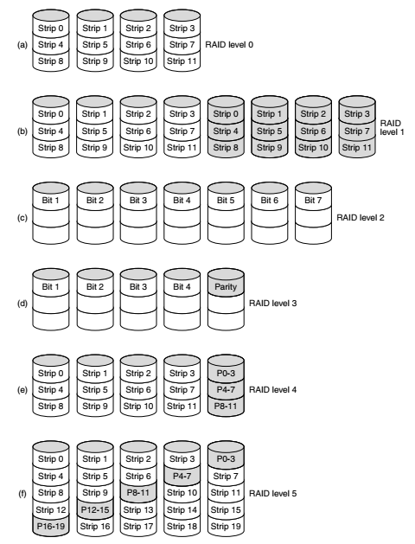
RAID levels

Slide 31
SaaS: Example - SalesForce

Slide 32
Salesforce.com
Salesforce is a leading provider of business software via the SaaS or software-as-a-service model
It has got a diverse line of products, from a CRM to AI analytics and a platform for app development
As a SaaS, Salesforce is cloud-based, meaning when you buy from SF you do not install anything or buy additional hardware
Salesforce is accessed by its users via the internet
All its services, from its sales cloud to IoT platform, are all deployed through the cloud

Slide 33
AWS Introduction

Slide 34
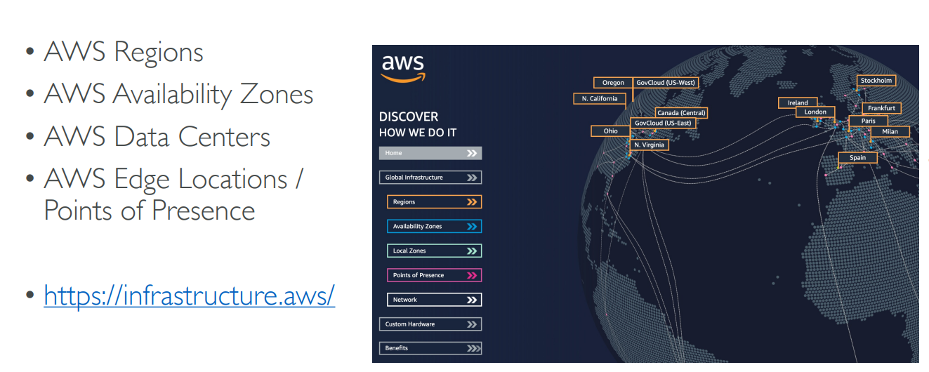
AWS Global Infrastructure

Slide 35
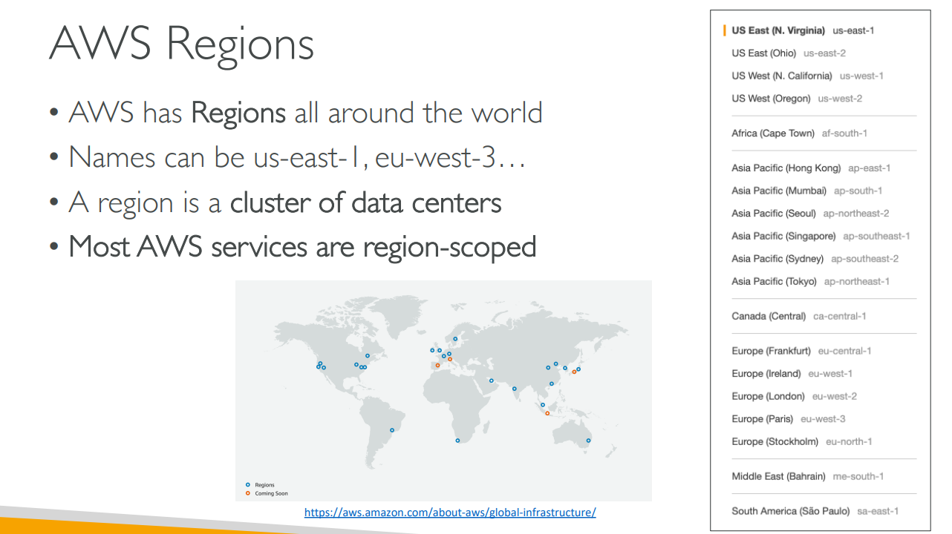
AWS Regions

Slide 36
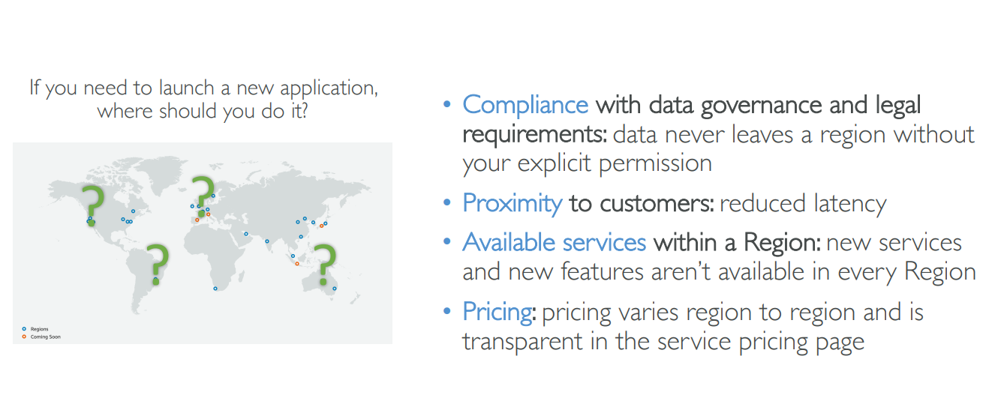
How to choose an AWS Region?

Slide 37
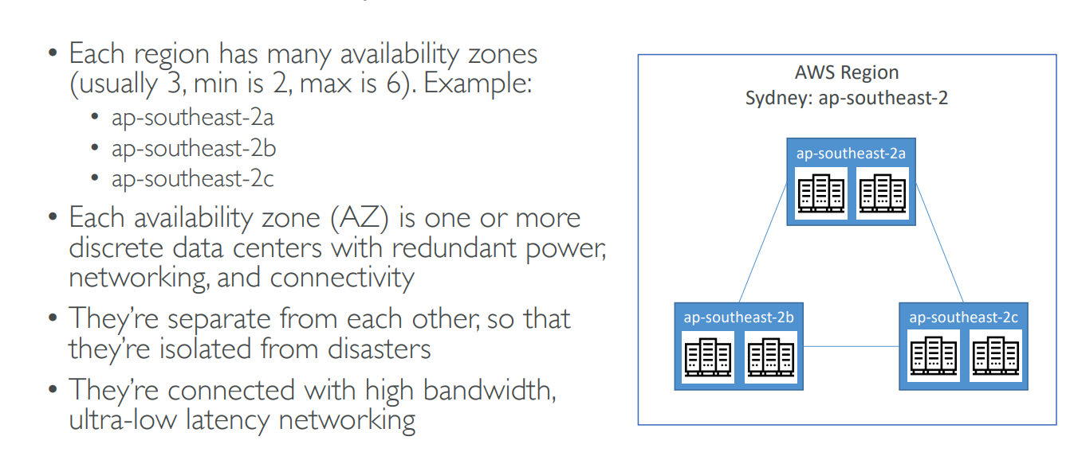
AWS Availability Zones

Slide 38
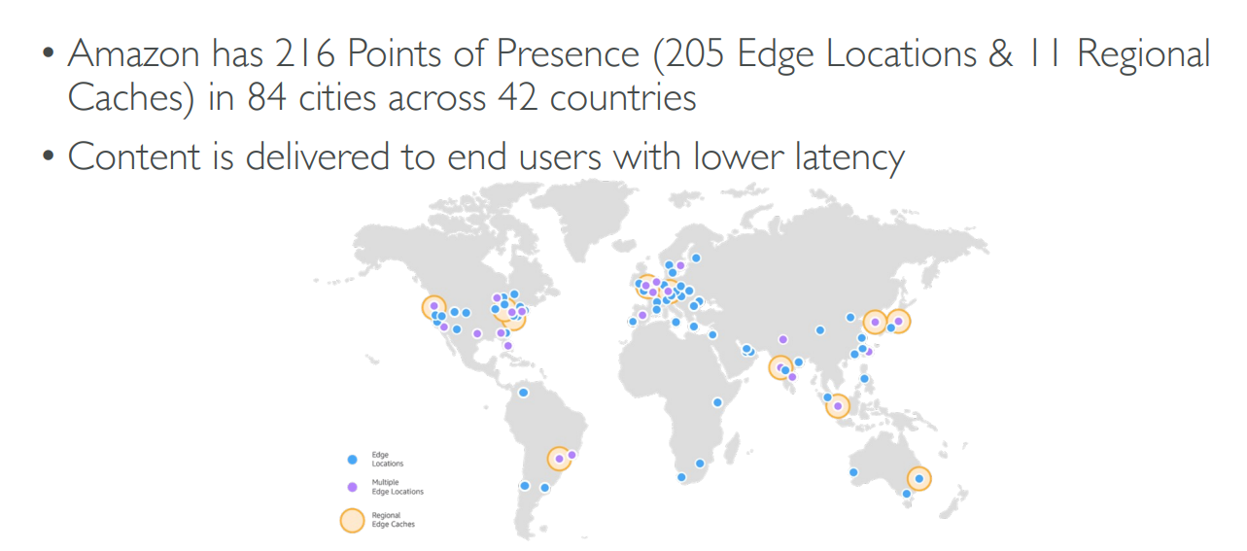
AWS Points of Presence (Edge Locations)

Slide 39
Signup
Signup for AWS with your email id
Remember the id, password and also the AWS account id (different from your email id) – This creates a root account
You will require your phone and credit card

Slide 40
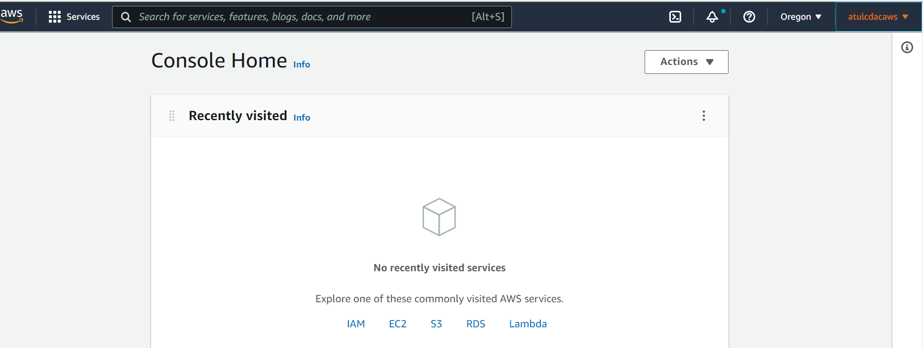
After successful signup

Slide 41
EC2

Slide 42
EC2 Basics
One of the most popular AWS offerings
EC2 = Elastic Compute Cloud = IaaS
Capabilities:
Rent a VM (EC2)
Store data on a virtual drive (EBS)
Distribute load across machines (ELB)
Scale the services using auto scaling group (ASG)

Slide 43
EC2 User Data
It is possible to bootstrap our instances using the EC2 User Data
Bootstrapping = Launching commands when a machine starts
This script is run only once at the first start
Used to automate boot tasks such as
Installing updates
Installing software
Downloading common files from the internet
Etc
EC2 User Data script must be run as a root user, so we may need sudo

Slide 44
Create an EC2 Instance using EC2 User Data
Search for EC2, then click on Instances, Launch Instances
Leave everything as default, but click on Create new key pair, as it is required – Give some name, and select defaults
Under Network, select Allow Http traffic from the internet
In Advanced details-User data, enter the following script
#!/bin/bash
# Use this for your user data (script from top to bottom)
# install httpd (Linux 2 version)
yum update -y
yum install -y httpd
systemctl start httpd
systemctl enable httpd
echo "<h1>Hello World from $(hostname -f)</h1>" > /var/www/html/index.html
Launch instance

Slide 45
Test the EC2 Instance
When the instance is running, open its public IP address in the browser

Slide 46
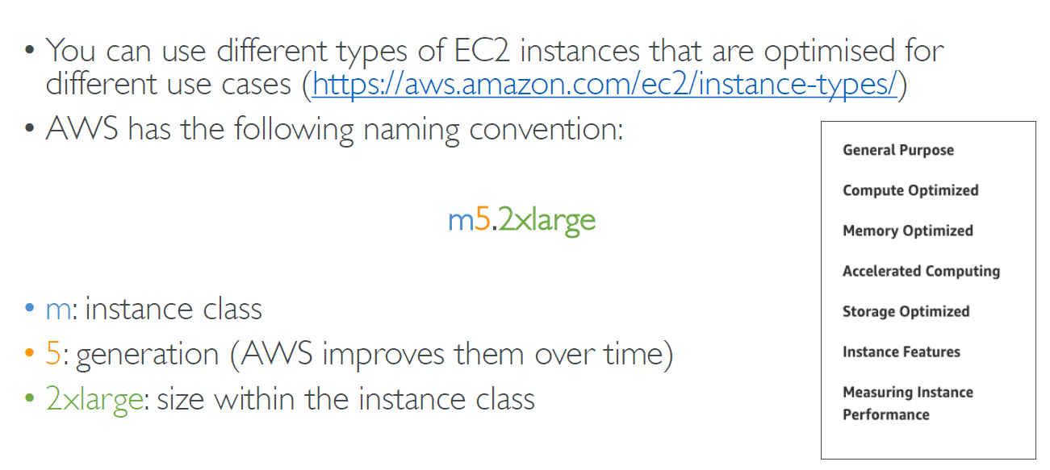
EC2 Instance Types – Overview

Slide 47
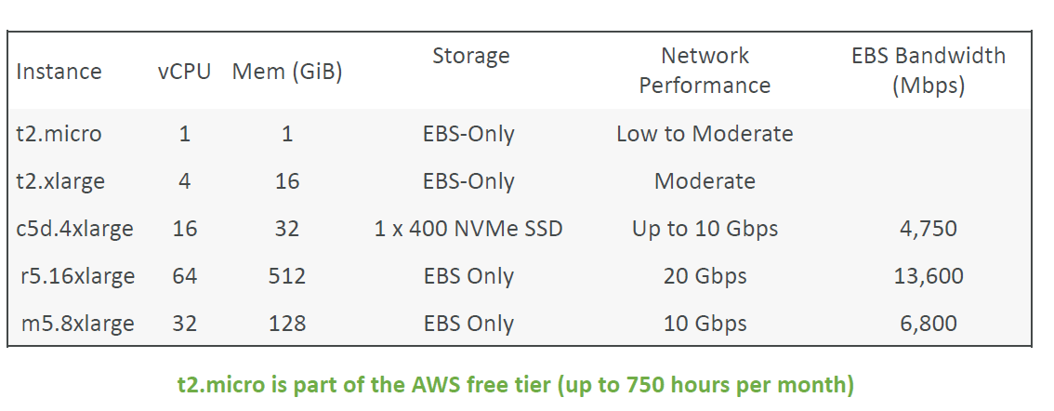
EC2 Instance Types – Example

Slide 48
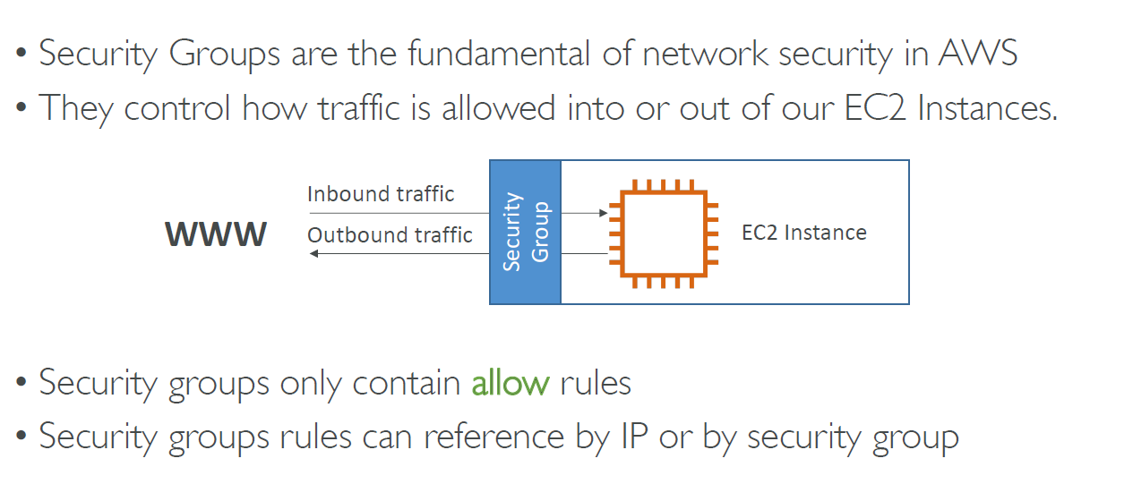
Security Groups and Classic Ports

Slide 49
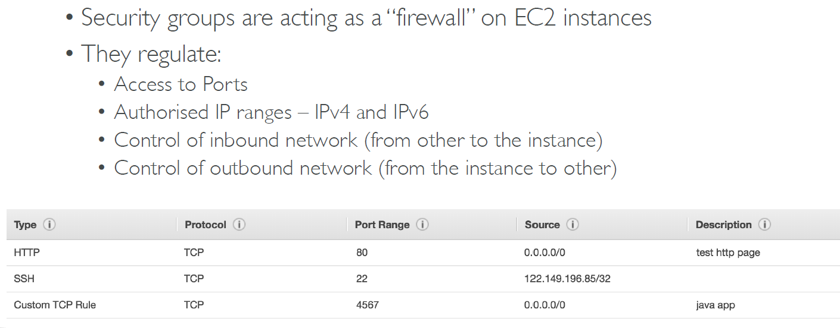
Security Groups

Slide 50
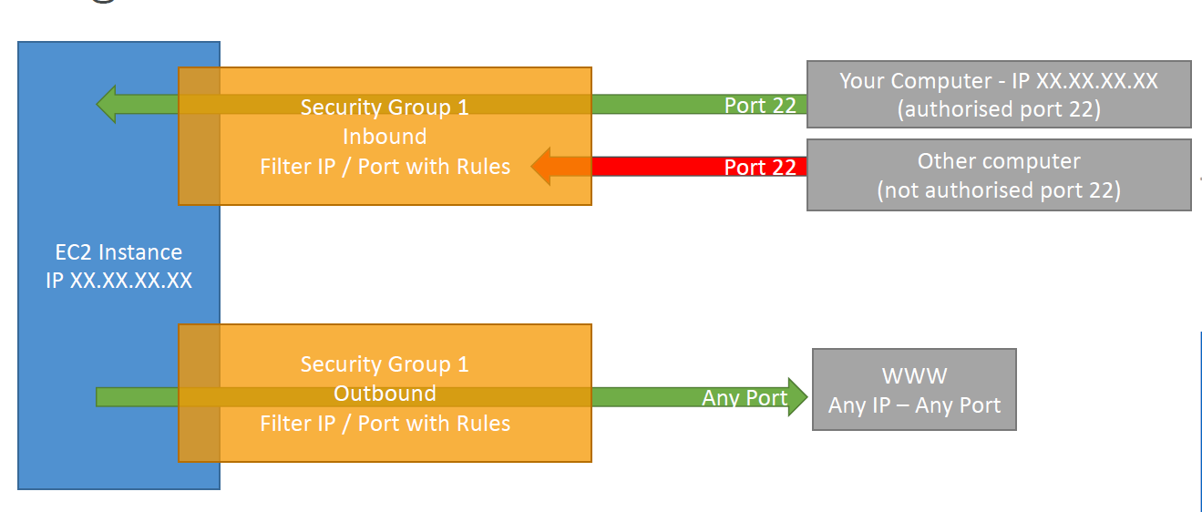
Security Groups - Example

Slide 51
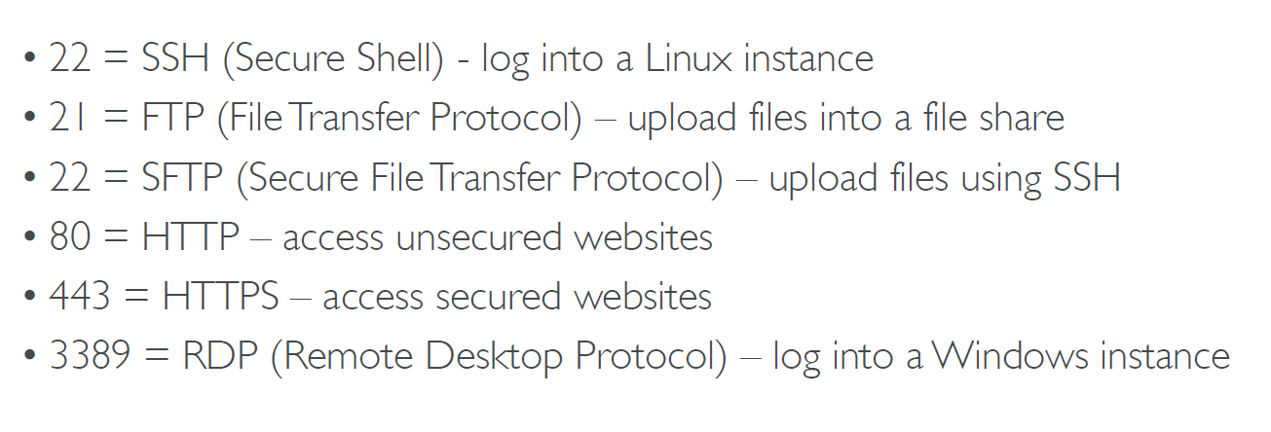
Ports to Remember

Slide 52
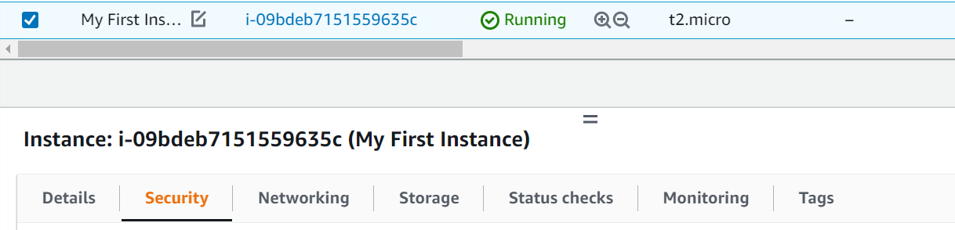
Security Groups – Hands on
Launch an instance, select it and go to ‘Security’ below
Left menu: Network & Security -> Security Groups

Slide 53
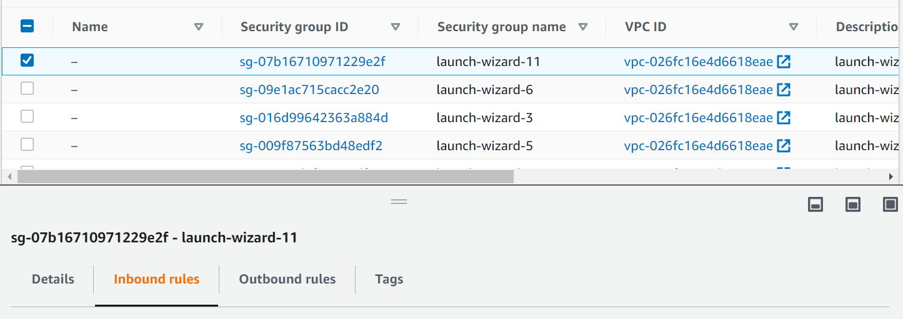
Security Groups – Hands on
Select the latest launched instance and check Inbound rules
SSH is allowed

Slide 54
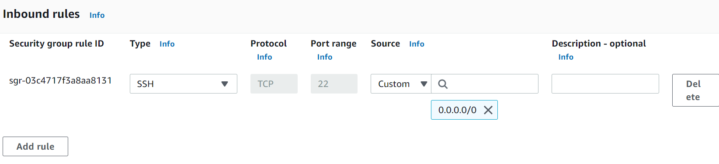
Security Groups – Hands on
Click on Edit Inbound rules to see details
If we see HTTP also, it means outsiders can access our instance, otherwise they cannot – test it (next slide)

Slide 55
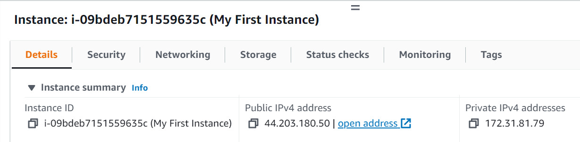
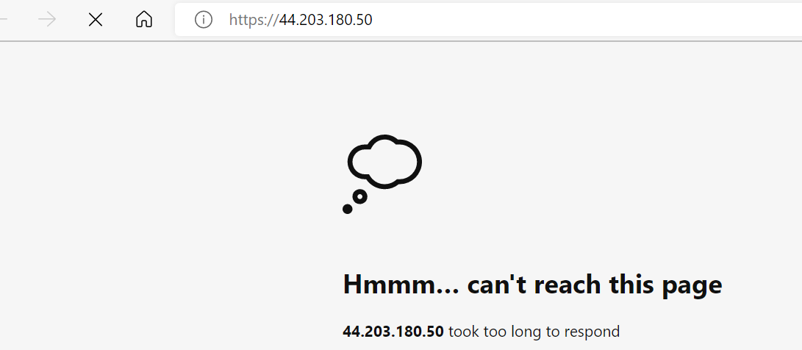
Security Groups – Hands on
Go back to our instance, details and click on the IP Address

Slide 56
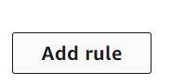
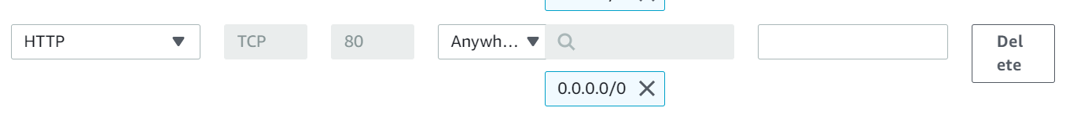
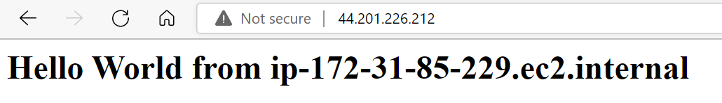
Security Groups – Hands on
If you were able to access, delete HTTP rule and retry then add back HTTP rule in Security policies -> Edit inbound rules

Slide 57
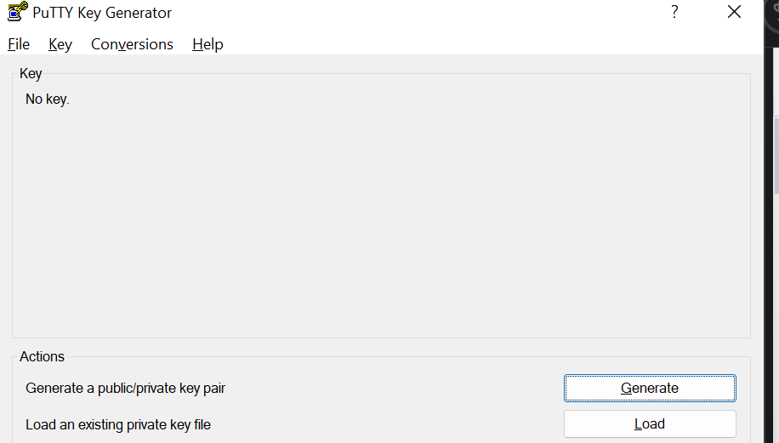
Using SSH – Putty
Download Putty (Windows software to connect to a Linux server using SSH)
First use Putty Gen to convert the private key file that you had downloaded when creating a key pair on EC2 from PEM format into PPT format and save it in the same directory
For this, click on Load

Slide 58
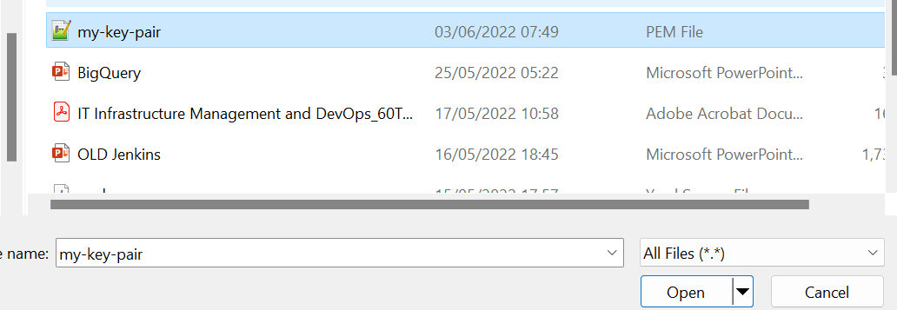
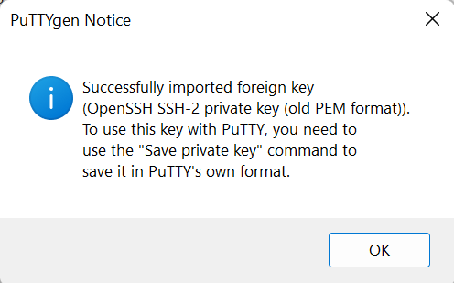
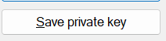
Puttygen

Slide 59
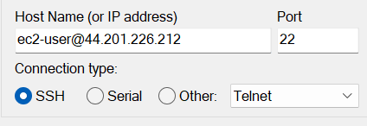
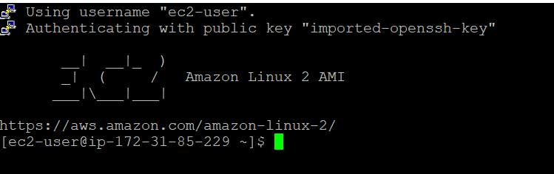
Now try Putty
ec2-user@Our instance’s IP address
SSH -> Auth -> Browse under ‘Private key for authentication’, then Open, Accept in Security alert

Slide 60
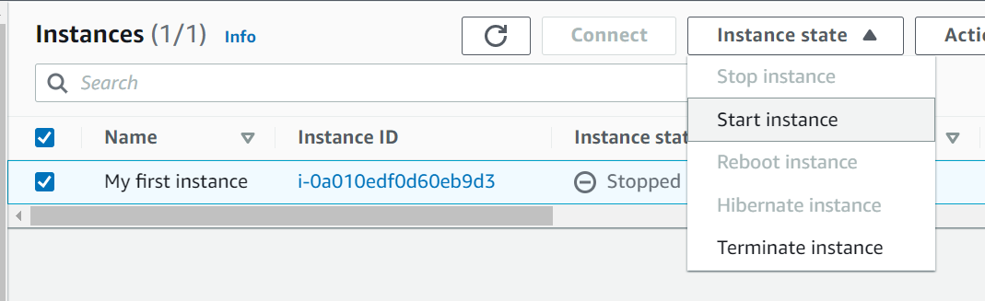
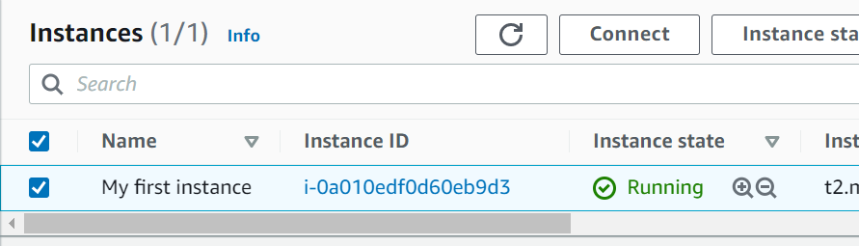
Alternative to SSH - EC2 Instance Connect
Start the instance
Select the instance and Connect

Slide 61
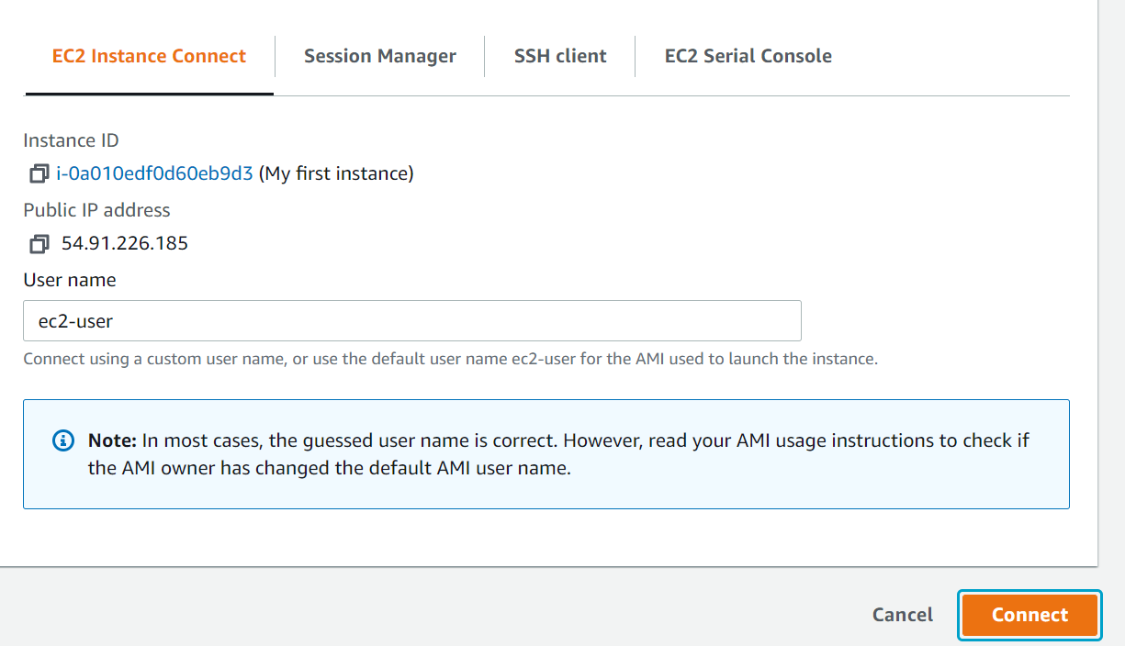
EC2 Instance Connect
Under ‘EC2 Instance Connect’ click on Connect

Slide 62
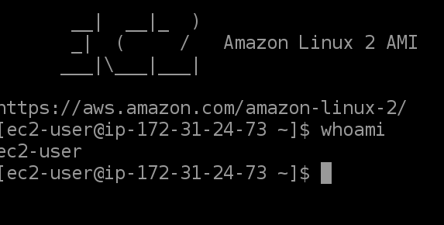
Result

Slide 63
Amazon Virtual Private Cloud (VPC)

Slide 64
VPC Basics
A Virtual Private Cloud (VPC) is a logically isolated portion of the AWS cloud within a region
It makes it private
Organization of VPC: Next slide

Slide 65
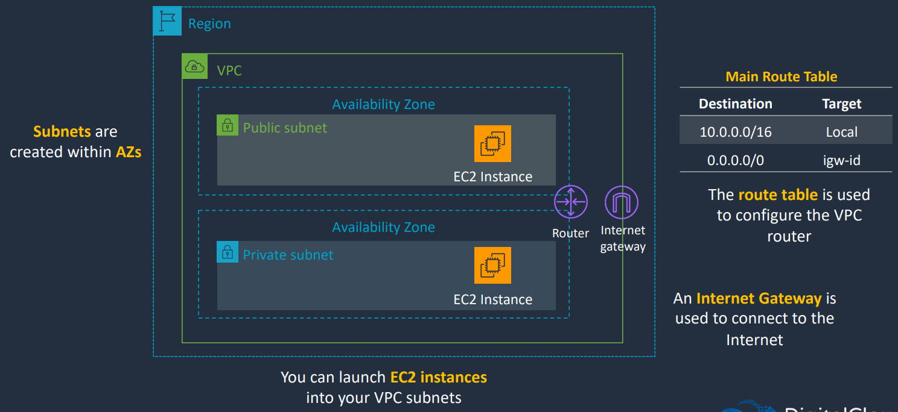
VPC Organization

Slide 66
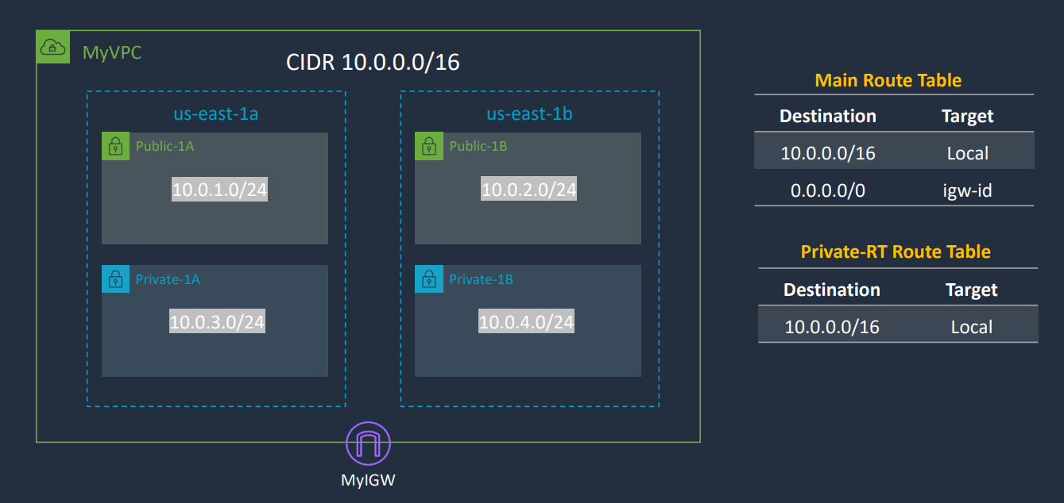
Creating a Custom VPC

Slide 67
Default VPC
Search for VPC in the AWS console and click on it
Select the region as US-East (N Virginia)
Click on Your VPCs – there should already be a VPC
Every region has a default VPC
That VPC has subnets in each Availability Zone (AZ) of that region
Click on the VPC id and we will see 6 subnets, since this region has 6 Azs
Click on the Route table and then its id
It should have a routing table with two addresses: One private network and the other is everything else, i.e. 0.0.0.0

Slide 68
Creating our Own VPC – Use these Values
# Create VPC
Name: MyVPC
IPv4 CIDR Block: 10.0.0.0/16
# Create Subnets
Name: Public-1A
Availability Zone: us-east-1a
IPv4 CIDR Block: 10.0.1.0/24
Name: Public-1B
Availability Zone: us-east-1b
IPv4 CIDR Block: 10.0.2.0/24
Name: Private-1A
Availability Zone: us-east-1a
IPv4 CIDR Block: 10.0.3.0/24
Name: Private-1B
Availability Zone: us-east-1b
IPv4 CIDR Block: 10.0.4.0/24
# Create private route table
Name: Private-RT
VPC: MyVPC
Subnet associations: Private-1A, Private-1B
# Create Internet Gateway
Name: MyIGW
VPC: MyVPC
## Create NAT Gateway
Name: MyNatGW
Subnet: Public-1A

Slide 69
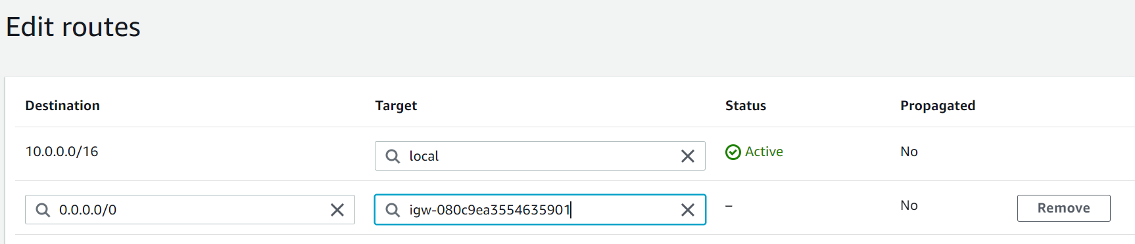
Creating a VPC
On the main VPC screen, click on Create VPC
Resources: VPC only
Use the values as shown on the next screen
Then select the VPC, Click Main route table and edit the routes, add the second route

Slide 70
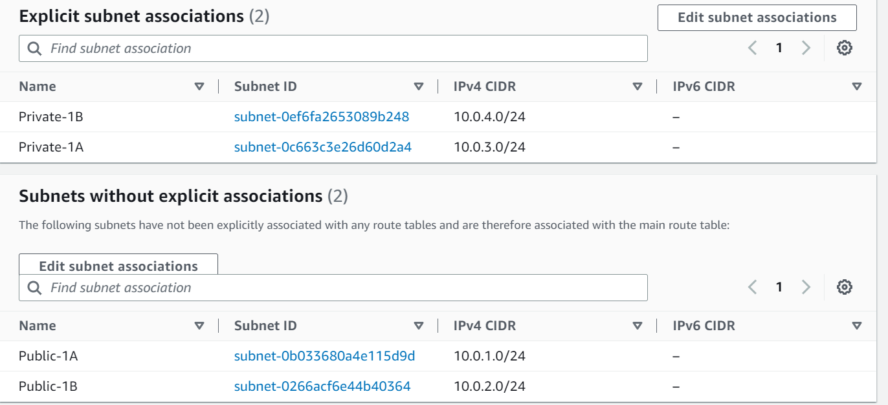
Subnet Associations
Click on Subnet associations, you will see entries only for public Ips, not for the private ones
Select the two private Ips and save – It should look like this now

Slide 71
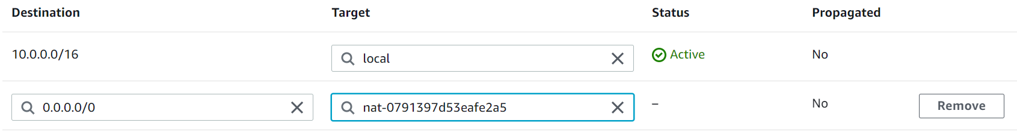
Setting up NAT
Go back to Route tables main option under Virtual private cloud on the left hand side, select Private-RT -> Edit routes
Add 0.0.0.0 and NAT

Slide 72
Done!
Our configuration is ready!

Slide 73
Clean up (Avoid Billing)
Delete NAT (Left menu)
Delete elastic IP (Left menu)
Delete VPC

Slide 74
AWS S3

Slide 75

AWS Storage Options

Slide 76

AWS Simple Storage Service (S3)

Slide 77

Details about S3

Slide 78

File Storage versus Object Storage

Slide 79

S3 Bucket Creation

Slide 80
Hands-on
Create an S3 bucket and add a file or two

Slide 81
Serverless and AWS Lambda

Slide 82
What is Serverless Computing?
Serverless does not mean no server
Serverless means the developers do not have to worry about servers
Developers just need to deploy code
AWS will manage the servers

Slide 83

Lambda Overview
AWS Lambda is a serverless compute service
Developer uploads some code – no payment at this stage
Charges only apply to the usage of the code

Slide 84


Lambda Overview
An event occurs
Triggers the Lambda function
It can run for max 15 mins

Slide 85
Hands-on
Ensure you have an AWS S3 bucket and an object (file) in it
Create an IAM execution role
Search for roles, you will see it under IAM-Roles, click on it
Choose Create role
Trusted entity type – AWS service
Use case – Lambda, then Next button
On the Add permissions page, type s3 in the search box. Select the checkbox next to the AmazonS3FullAccess managed AWS policy
Still on the Add permissions page, remove the previous s3 search filter and type basic in the search box. Select the checkbox next to the AWSLambdaBasicExecutionRole managed AWS policy. Choose Next.
On the Name, review, and create page, enter my-s3-function-role. Choose Create role.

Slide 86
Create Lambda Function
Open the Functions page of the Lambda console.
Choose Create function.
Choose Author from scratch.
Under Basic information, do the following:
For Function name, enter my-s3-function.
For Runtime, choose Python 3.9.
For Architecture, enter x86_64.
Expand the Change default execution role tab. Choose Use an existing role, then choose the my-s3-function-role you created earlier.
Choose Create function.

Slide 87
Create Amazon S3 Trigger
In the Functions page of the Lambda console, choose the function (my-s3-function) that you created earlier.
Choose Add trigger.
Choose S3 as the source.
For Bucket, choose the bucket you created earlier. Keep the other default settings.
Acknowledge the Recursive invocation warning.
Choose Add.

Slide 88
Write the Functions Code
Your Lambda function will retrieve the source S3 bucket name and the key name of the uploaded object from the event parameter that it receives.
The function uses the Amazon S3 getObject API to retrieve the content type of the object.
Visit https://serverlessland.com/snippets/integration-s3-to-lambda?utm_source=aws&utm_medium=link&utm_campaign=python&utm_id=docsamples&tab=python
Copy the code and paste it in lambda_functions.py
Click Deploy

Slide 89
Test the Lambda Function using S3 Trigger
On the Buckets page of the Amazon S3 console, choose the name of the source bucket that you created earlier.
On the Upload page, upload more .jpg or .png image files to the bucket.
Open the Functions page of the Lambda console.
Choose the name of your function (my-s3-function).
To verify that the function ran once for each file that you uploaded, choose the Monitor tab. This page shows graphs for the metrics that Lambda sends to CloudWatch. The count in the Invocations graph should match the number of files that you uploaded to the Amazon S3 bucket.

Slide 90
Clean up
Delete the Lambda function
Empty the S3 bucket
Delete the S3 bucket

Slide 91
Multi-tenancy

Slide 92
Multi-tenancy in Cloud
In cloud computing, multi-tenancy is all about sharing, i.e. multiple customers are served by a single instance of an application.
Sharing resources such as configurations, user management rules, and data – all of which can be customized and physically integrated but logically separated.
Types of multi-tenant cloud architectures

Slide 93
Types of Multi-tenant Cloud Architectures
One App Instance, One Database
A single instance of the software will support single databases.
This multi-tenancy architectural style offers scalability and increases capacity as and when the tenants increase.
However, the biggest drawback of one app instance, one database is the noisy-neighbour effect. (When multiple tenants make requests to the same database server, performance issues can occur resulting in noisy neighbours.)
One App Instance, Several Databases
A single instance of the software supports multiple databases. This can get expensive as you are asking for a separate space to store the tenant data.

Slide 94
Degrees of Multi-Tenancy
The degree of multi-tenancy is based on how much of the core application (SaaS) layer is designed to be shared across tenants.
The highest degree of multi-tenancy allows the database schema to be shared and supports customization of the business logic, workflow and user-interface layers.
In other words, all the sub-layers of SaaS offer multi-tenancy in this degree.
In the lowest degree, multi-tenancy is limited to the IaaS and PaaS layers, with dedicated SaaS layers for each tenant.
Examples
Salesforce.com, at the relatively high end of the multi-tenancy spectrum, has 72,500 customers who are supported by 8 to 12 multi-tenant instances (meaning IaaS/PaaS instances) in a 1:5000 ratio. So, each multi-tenant instance supports 5,000 tenants who share the same database schema.
Intacct, a financial systems SaaS provider has more than 2,500 customers who share 10 instances in a 1:250 ratio.

Slide 95
Multi-Tenancy Data Architecture
Four Approaches
Single database, shared schema
Single database, separate schema
Database per tenant
Multiple databases, multiple tenants per database, shared schema

Slide 96

Single Database, Shared Schema
One database to hold the data for all tenants
Every tenant's data is stored in the same set of tables
Tables that contain tenant-specific data include a column to identify which tenant each row belongs to

Slide 97

Single Database, Separate Schema
One database to hold the data for all tenants
Separate tables for each tenant, each set under a tenant-specific schema

Slide 98

Database Per Tenant
Each tenant has its own database

Slide 99

Multiple Databases, Multiple Tenants Per Database, Shared Schema
Hybrid of approach #1 and approach #3
A pool of databases exist
Tenants share a database and schema with other tenants, but are spread over multiple databases

Slide 100
How to Choose Multi-Tenancy Degree?
How much is the workload?
What is the type of application?
Example: Can a central vendor host an application for multiple clients that can share the same schema?
Security, Authorization

Slide 101
How to decide Level of Multi-tenancy?
https://docs.microsoft.com/en-us/azure/architecture/guide/multitenant/considerations/tenancy-models
https://cloud.google.com/kubernetes-engine/docs/best-practices/enterprise-multitenancy

